Slide 1
Healthy Churches avoid worldliness
1 Timothy 6:3-21
Preached by Dr. Jim Harmeling at Crossroads International Church Singapore • cicfamily.com Uploaded by Dr. Rick Griffith • Singapore Bible College Thousands of files in 49 languages for free at BibleStudyDownloads.org

Slide 2
Covid-19
Online education
Lockdown
Uncertain economy
Stay-cation
Internet issues
World crises
Out of ice cream!

Slide 3
Healthy Church Life
Studies in 1 Timothy

Slide 4
Healthy Churches
Guard the gospel message (1)
Pray (2)
Develop godly leaders (3)
Discern truth from error (4)
Honor each other (5)

Slide 5
Healthy Churches avoid worldliness
1 Timothy 6:3-21

Slide 6
They are content with the Lord’s provision
(1 Timothy 6:3-10)

Slide 7
Philippians 4:11
“Not that I am speaking of being in need, for I have learned in whatever situation I am to be content.”

Slide 8
Romans 8:5-6
⁵ For those who live according to the flesh set their minds on the things of the flesh, but those who live according to the Spirit set their minds on the things of the Spirit. ⁶ For to set the mind on the flesh is death, but to set the mind on the Spirit is life and peace.

Slide 10
Beware of teachers who are not content with godliness (6:3-5)
They offer an alternate perspective on Christ (v. 3)

Slide 11
Ideas about Jesus through the centuries
Emphasize
Jesus’ divinity
Mystical, detached
AD 100 – 2020
Emphasize
Jesus’ humanity
Social justice, political revolutionary

Slide 12
Beware of teachers who are not content with godliness (6:3-5)
They offer an alternate perspective on Christ (v. 3)
They have a sick desire for debate (v. 4a)
They create division in the church (vs. 4b-5)

Slide 13
Beware of teachers who are not content with godliness (6:3-5)
Discover contentment in the Lord (6:6-10)

Slide 14
2 Corinthians 12:8-9
⁸ Three times I pleaded with the Lord about this, that it should leave me. ⁹ But he said to me, “My grace is sufficient for you, for my power is made perfect in weakness.” Therefore I will boast all the more gladly of my weaknesses, so that the power of Christ may rest upon me.

Slide 15
Beware of teachers who are not content with godliness (6:3-5)
Discover contentment in the Lord (6:6-10)
Earthly wealth is not eternal (vs. 6-7)

Slide 16
Hebrews 13:5
Keep your life free from love of money, and be content with what you have, for he has said, “I will never leave you nor forsake you.”

Slide 17
Beware of teachers who are not content with godliness (6:3-5)
Discover contentment in the Lord (6:6-10)
Earthly wealth is not eternal (vs. 6-7)
Contentment is possible in simplicity (v. 8)
Discontentment with present provision is dangerous (vs. 9-10)

Slide 18
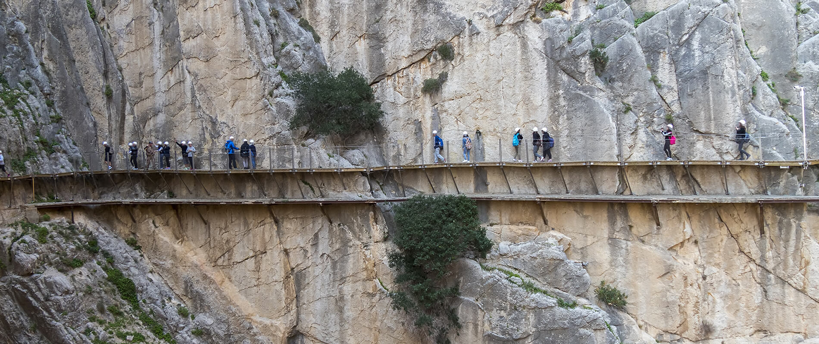
Discontentment entraps
Discontentment leads to other evil desires

Slide 19
“Avarice leads to selfishness, cheating, fraud, perjury and robbery, to envy, quarrelling and hatred, to violence and even murder. Greed lies behind marriages of convenience, perversions of justice, drug-pushing, pornography sales, blackmail, the exploitation of the weak, the neglect of good causes, and the betrayal of friends.”
John Stott

Slide 20
Discontentment entraps
Discontentment leads to other evil desires
Discontentment can ruin our lives
Discontentment can lead us astray from God

Slide 22
NT Preaching • BibleStudyDownloads.org
Get this presentation for free!

